Slide 1

Capstone Project MBS Realestate
Rajesh Nagarjunan
Date: 29 Jan 2021

Slide 2
Realestate Project – Problem Statement
Problem / Painpoint:
MBS (Mortgage Backed Securities) trading requires a very good understanding of user base which they seem to be missing !
Approach & Learning:
1. Understanding the problem space and domain is key
2. Explore solution space to see how much we can get from this data
3. Explore Models, Accuracy, Error, Validate
Solution :
1. How would this look like and what is our USP (Unique Selling Point)
2. Solution space and limitless possibilities for expansion
3. Learnings

Slide 3

“If you can film an idea in your mind, follow that film idea shot for shot, scene for scene, that idea is worth making.
- Craig Mapp

Slide 4
Realestate Project – Problem Statement
MBS Structuring : Complex business that cannot be performed without good understanding of what is happening in the market
MBS Trading : Requires insights on how the trends are moving and without this the traders are blindsided
Pain Point 1: Huge amount of data exists but a good summary of key features identified through analytics is missing
Pain Point 2: Need a daily report of the Analytic features that require to be applied to the product strategy, first thing every morning on desk. And with this a dashboard for boardroom discussions

Slide 5
What would the MBS traders like to see ?
I would want to see if my product structure still fits the market in terms of its original purpose
I would want to understand any change in trends day on day as we move forward
I would want to get an understanding of demographics by age, sex, location etc
I would want to know that I have full control over my client finances and can report back to regulators with confidence that there is adequate guard rails for financial risks / avoid melt down?

Slide 6
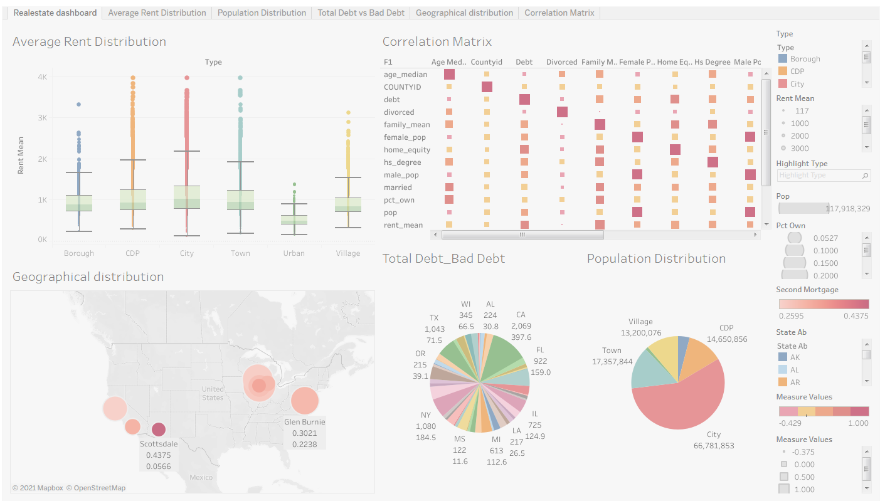
Final Outcome

Slide 7
Approach
List of activites
Data Import
Data Profiling
Missing Value Treatment
Maximum Debt Mortgage
Bad Debt vs Total Debt
Second Mortgage Distribution
Home Equity Distribution
Good and Bad Debt Distribution
Analyse
Population Density, Median Age, Group Bins, Marital Status
Overall Income Level, Corelation Analysis

Slide 8
Week 1 – Understanding Key Data Elements
Variables | Description
Second mortgage | Households with a second mortgage statistics
Home equity | Households with a home equity loan statistics
Debt | Households with any type of debt statistics
Mortgage Costs | Statistics regarding mortgage payments, home equity loans, utilities, and property taxes
Home Owner Costs | Sum of utilities, and property taxes statistics
Gross Rent | Contract rent plus the estimated average monthly cost of utility features
High school Graduation | High school graduation statistics
Population Demographics | Population demographics statistics
Age Demographics | Age demographic statistics
Household Income | Total income of people residing in the household
Family Income | Total income of people related to the householder

Slide 9
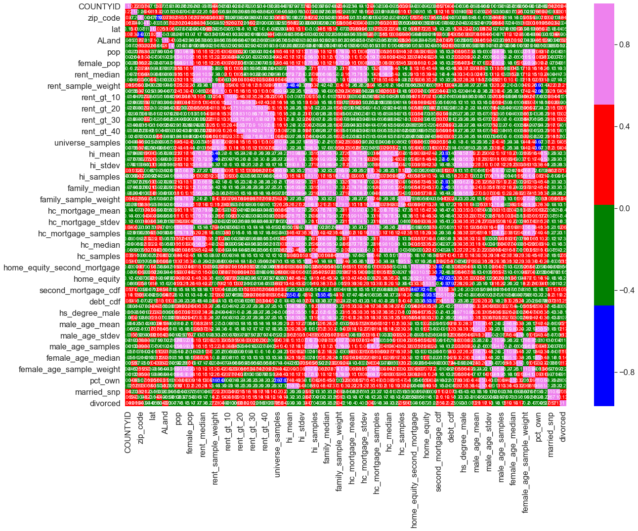
Outputs for Analysis
Check the heatmap to see how correlated are the data
Looking at this it seemed like there was too much data variants which correlated like mean, Deviation, Avg, etc.. Which could be ideally removed if their correlation was similar to just the value

Slide 10
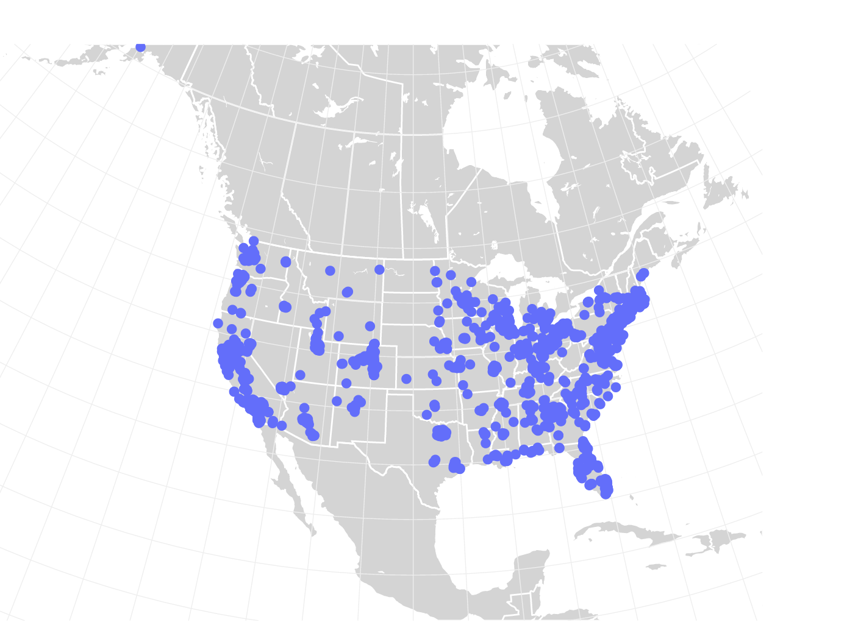
Week 2
Top 2,500 locations where the percentage of households with a second mortgage is the highest and percent ownership is above 10 percent.
place | pct_own | second_mortgage | lat | lng
0 | Worcester City | 0.20247 | 0.43363 | 42.254262 | -71.800347
1 | Harbor Hills | 0.15618 | 0.31818 | 40.751809 | -73.853582
2 | Glen Burnie | 0.22380 | 0.30212 | 39.127273 | -76.635265
3 | Egypt Lake-leto | 0.11618 | 0.28972 | 28.029063 | -82.495395
4 | Lincolnwood | 0.14228 | 0.28899 | 41.967289 | -87.652434

Slide 11
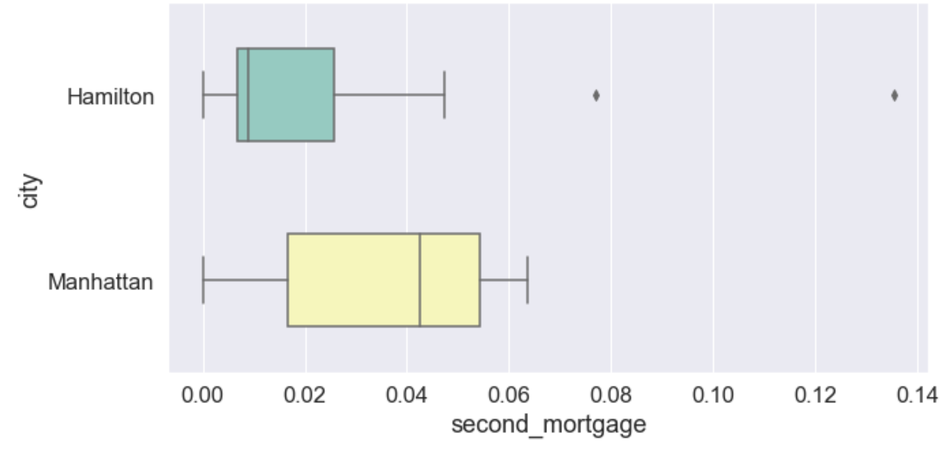
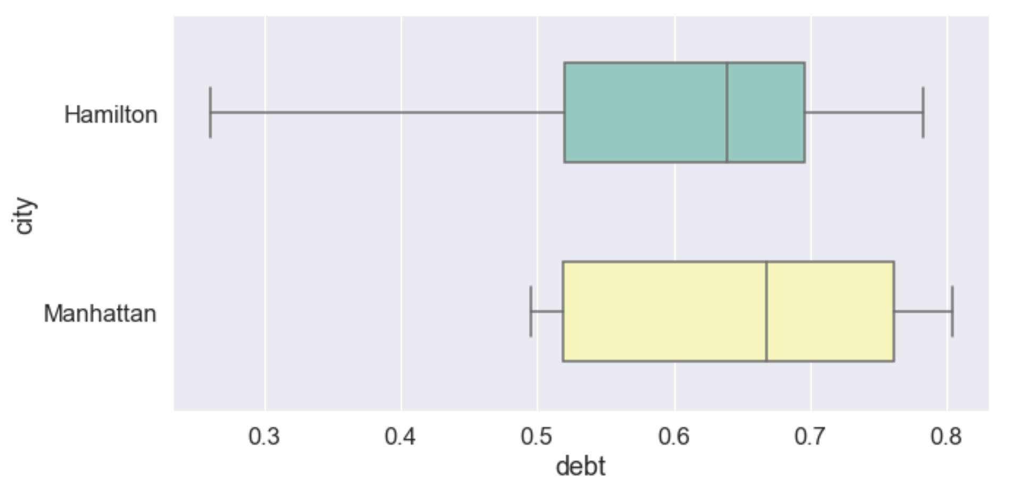
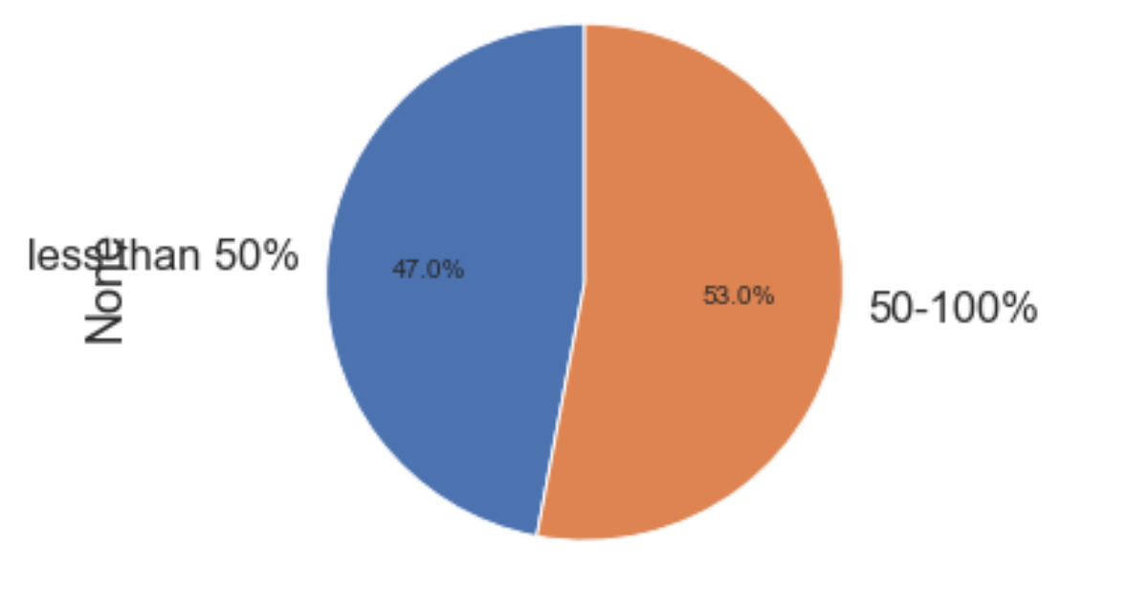
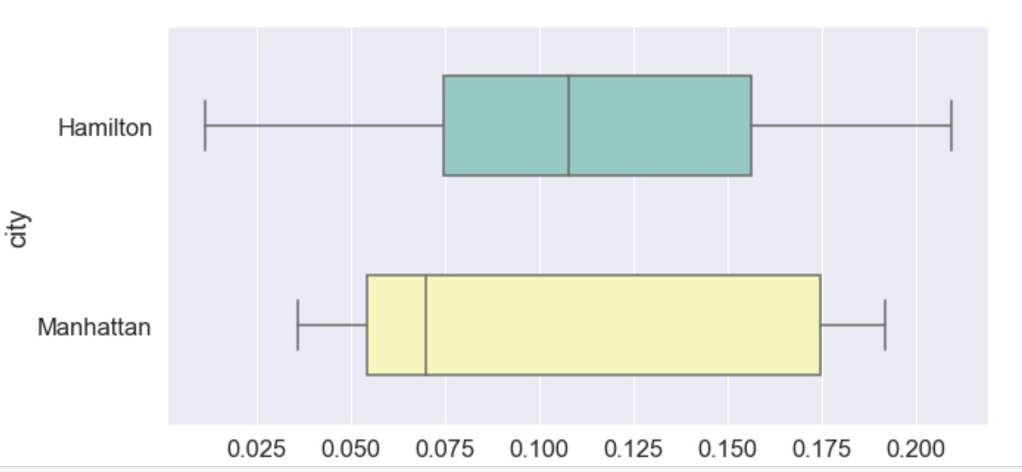
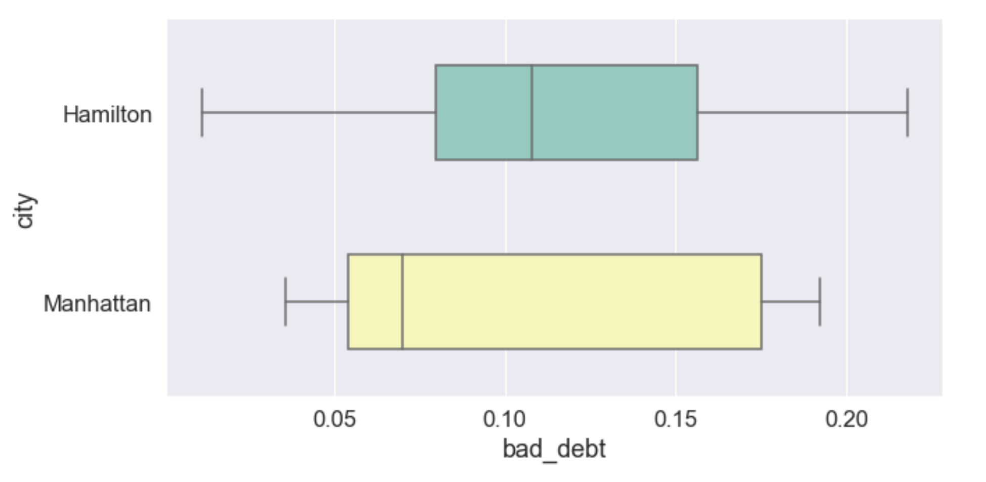
Week 2
Debt vs Bad debt comparison & distribution of 2nd mortgage, home equity, good debt, and bad debt for different cities

Slide 12
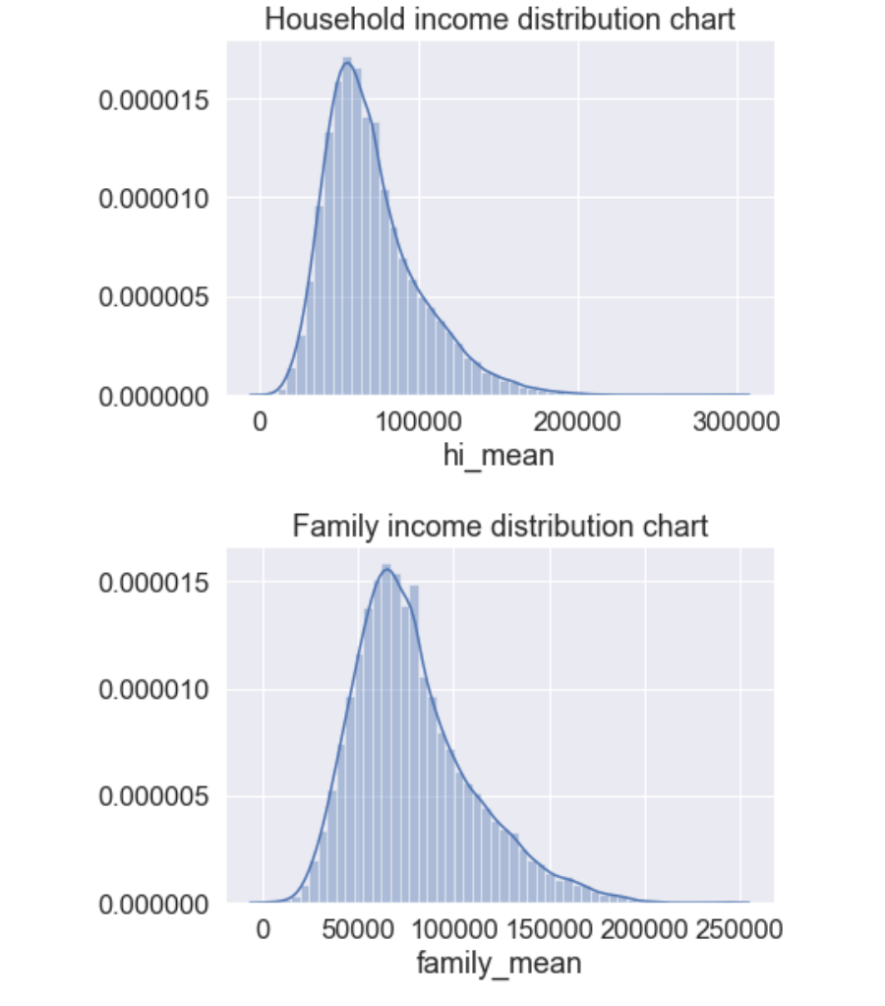
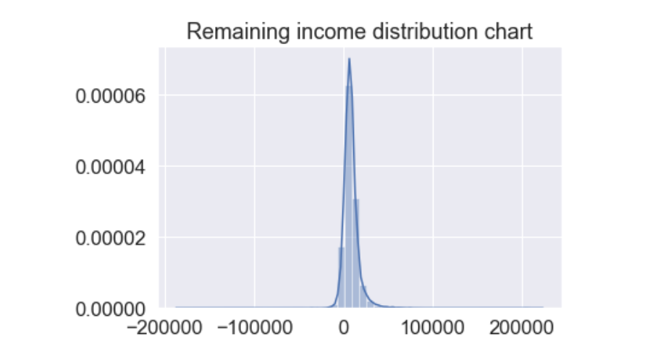
Week 3
Collated income distribution chart for family income, house hold income, and remaining income¶

Slide 13
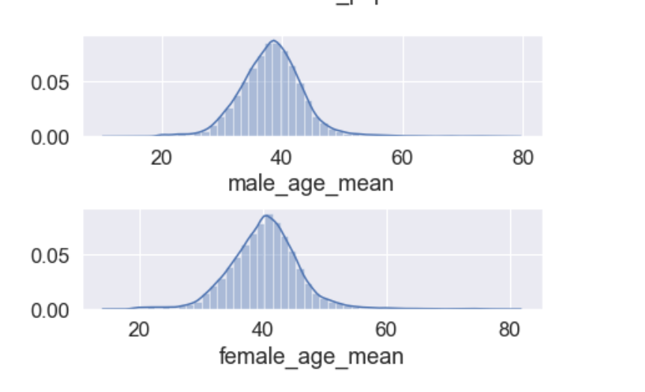
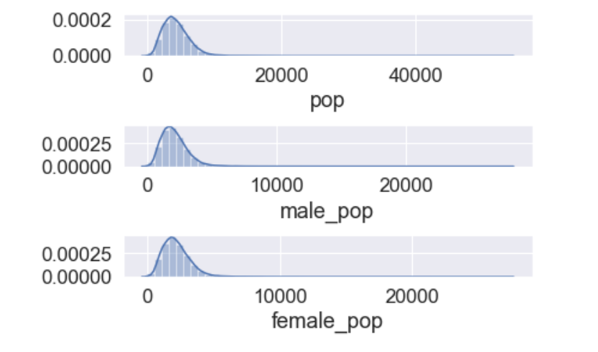
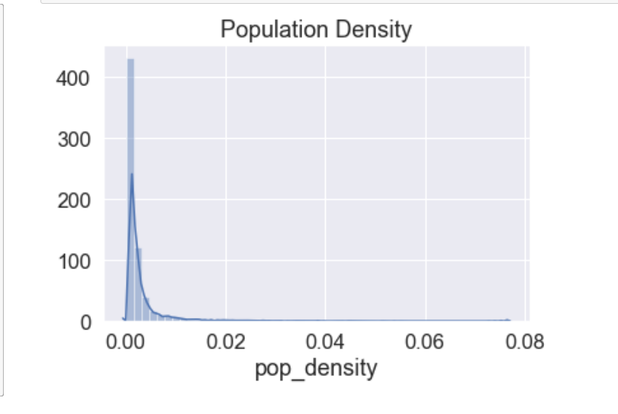
Week 3
EDA to come out with insights into population density and age.:¶

Slide 14
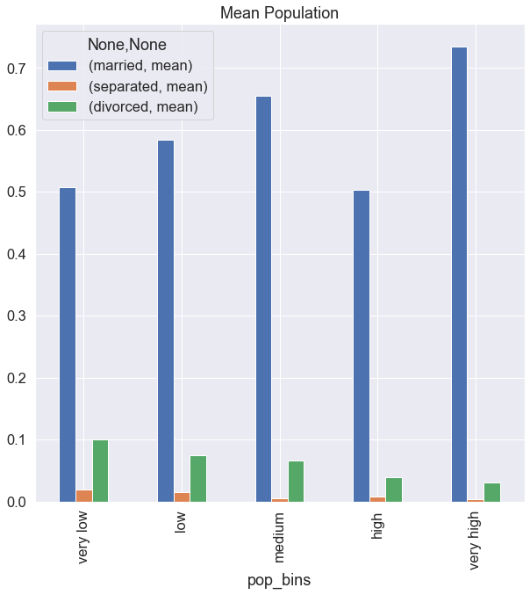
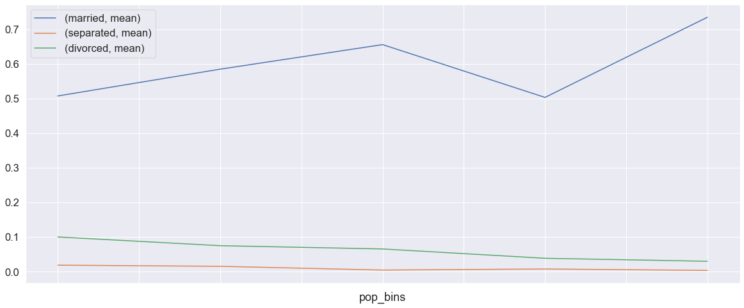
Week 3

Slide 15
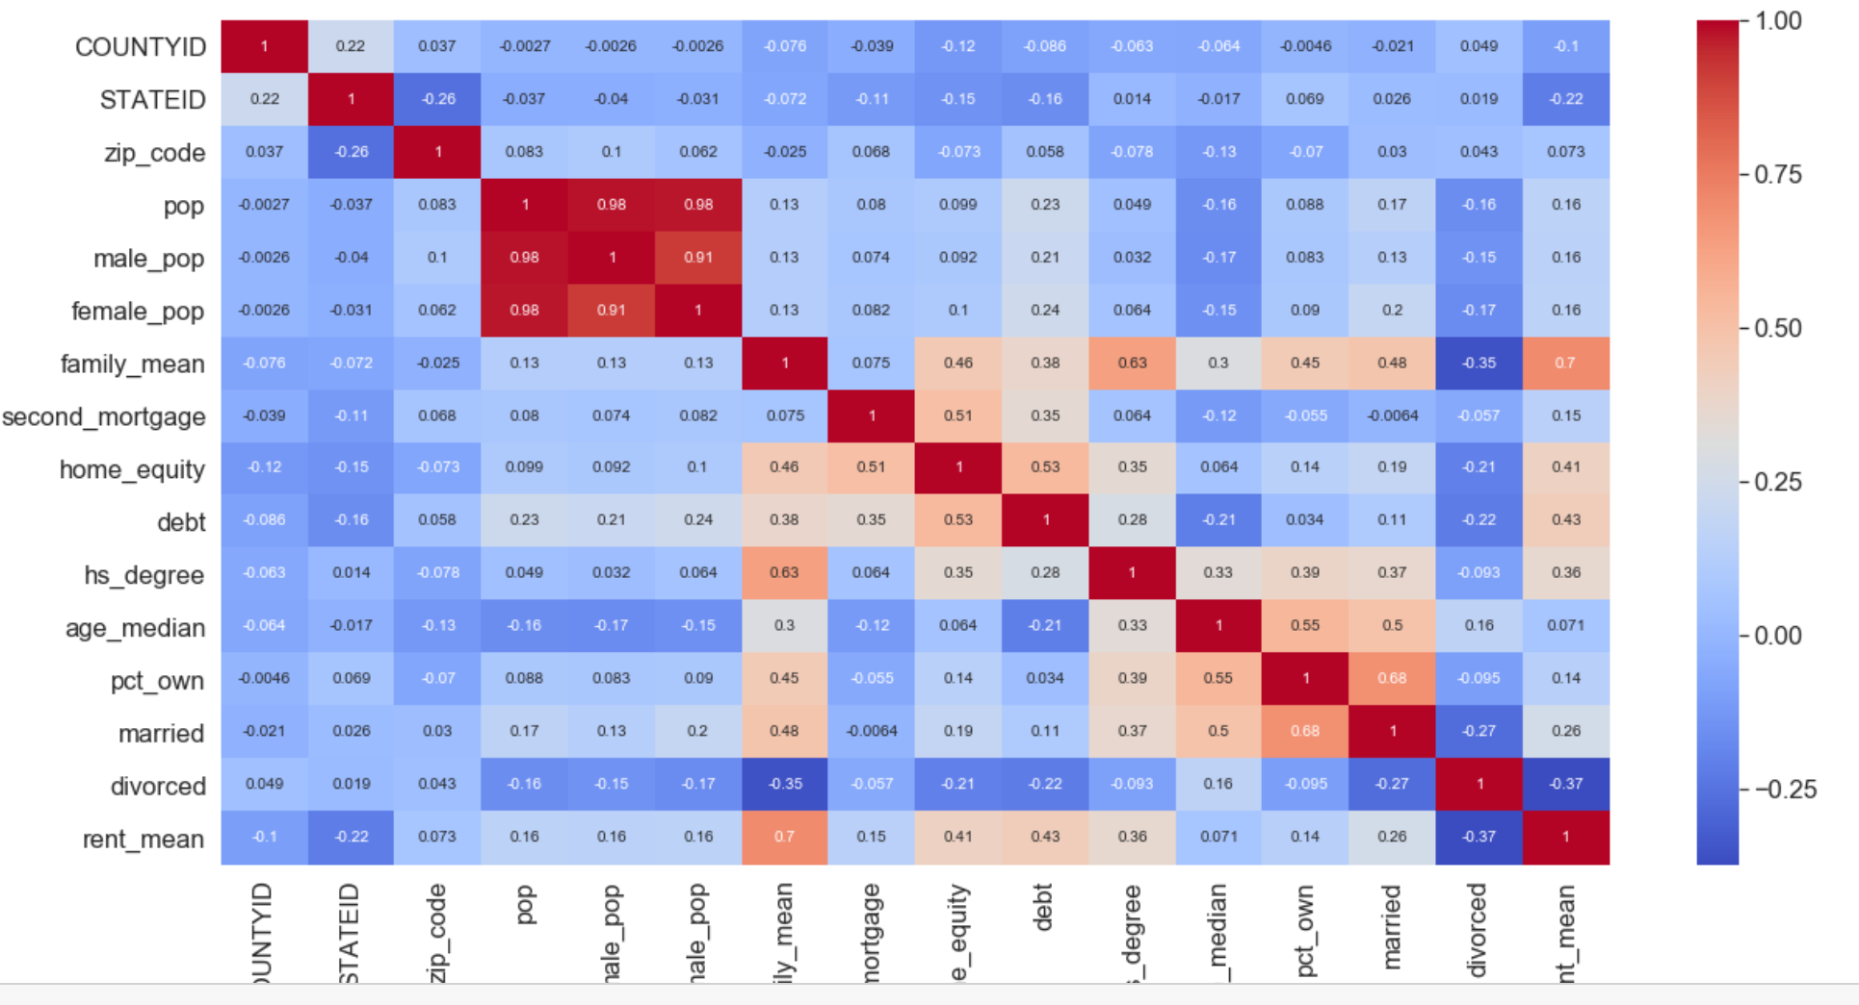
Week 3
Correlation between fields

Slide 16
Week 4
Learning
Factor Analysis to find Latent variables
Modelling
Nation Level
State Level
Variable Verification
Build a linear Regression model to predict the total monthly expenditure for home mortgages loan. • Variables should have significant impact on predicting Monthly mortgage and owner costs
Utilize all predictor variable to start with initial hypothesis
R square of 60 percent and above should be achieved
Ensure Multi-collinearity does not exist in dependent variables
Test if predicted variable is normally distributed

Slide 17
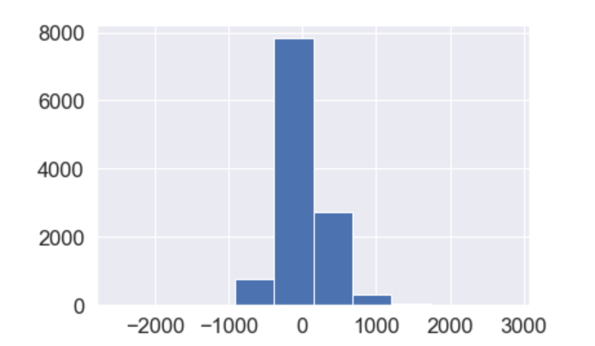
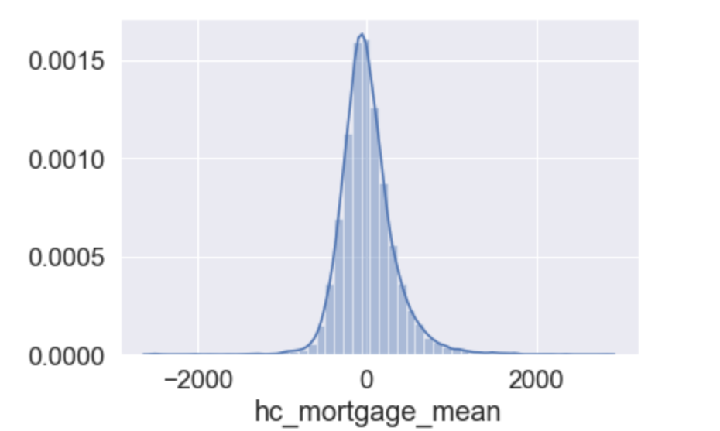
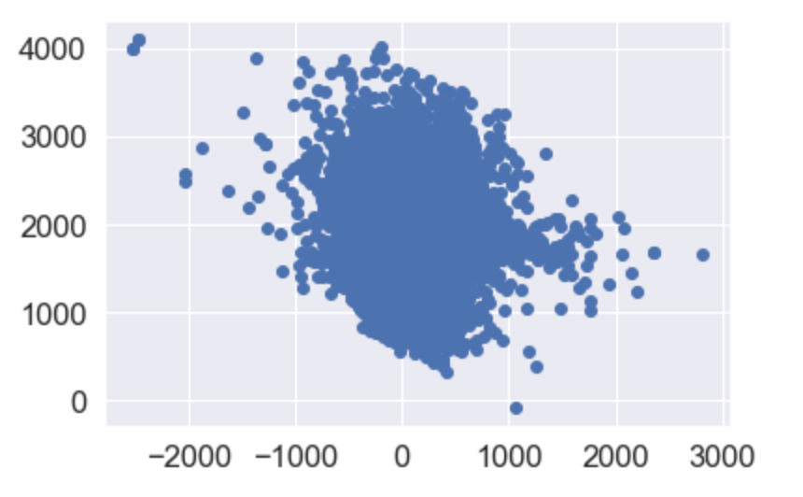
Week 4 Variable Verification
Checking Residuals of the Linear Regression model O/P
Normal Distribution of Residuals

Slide 18
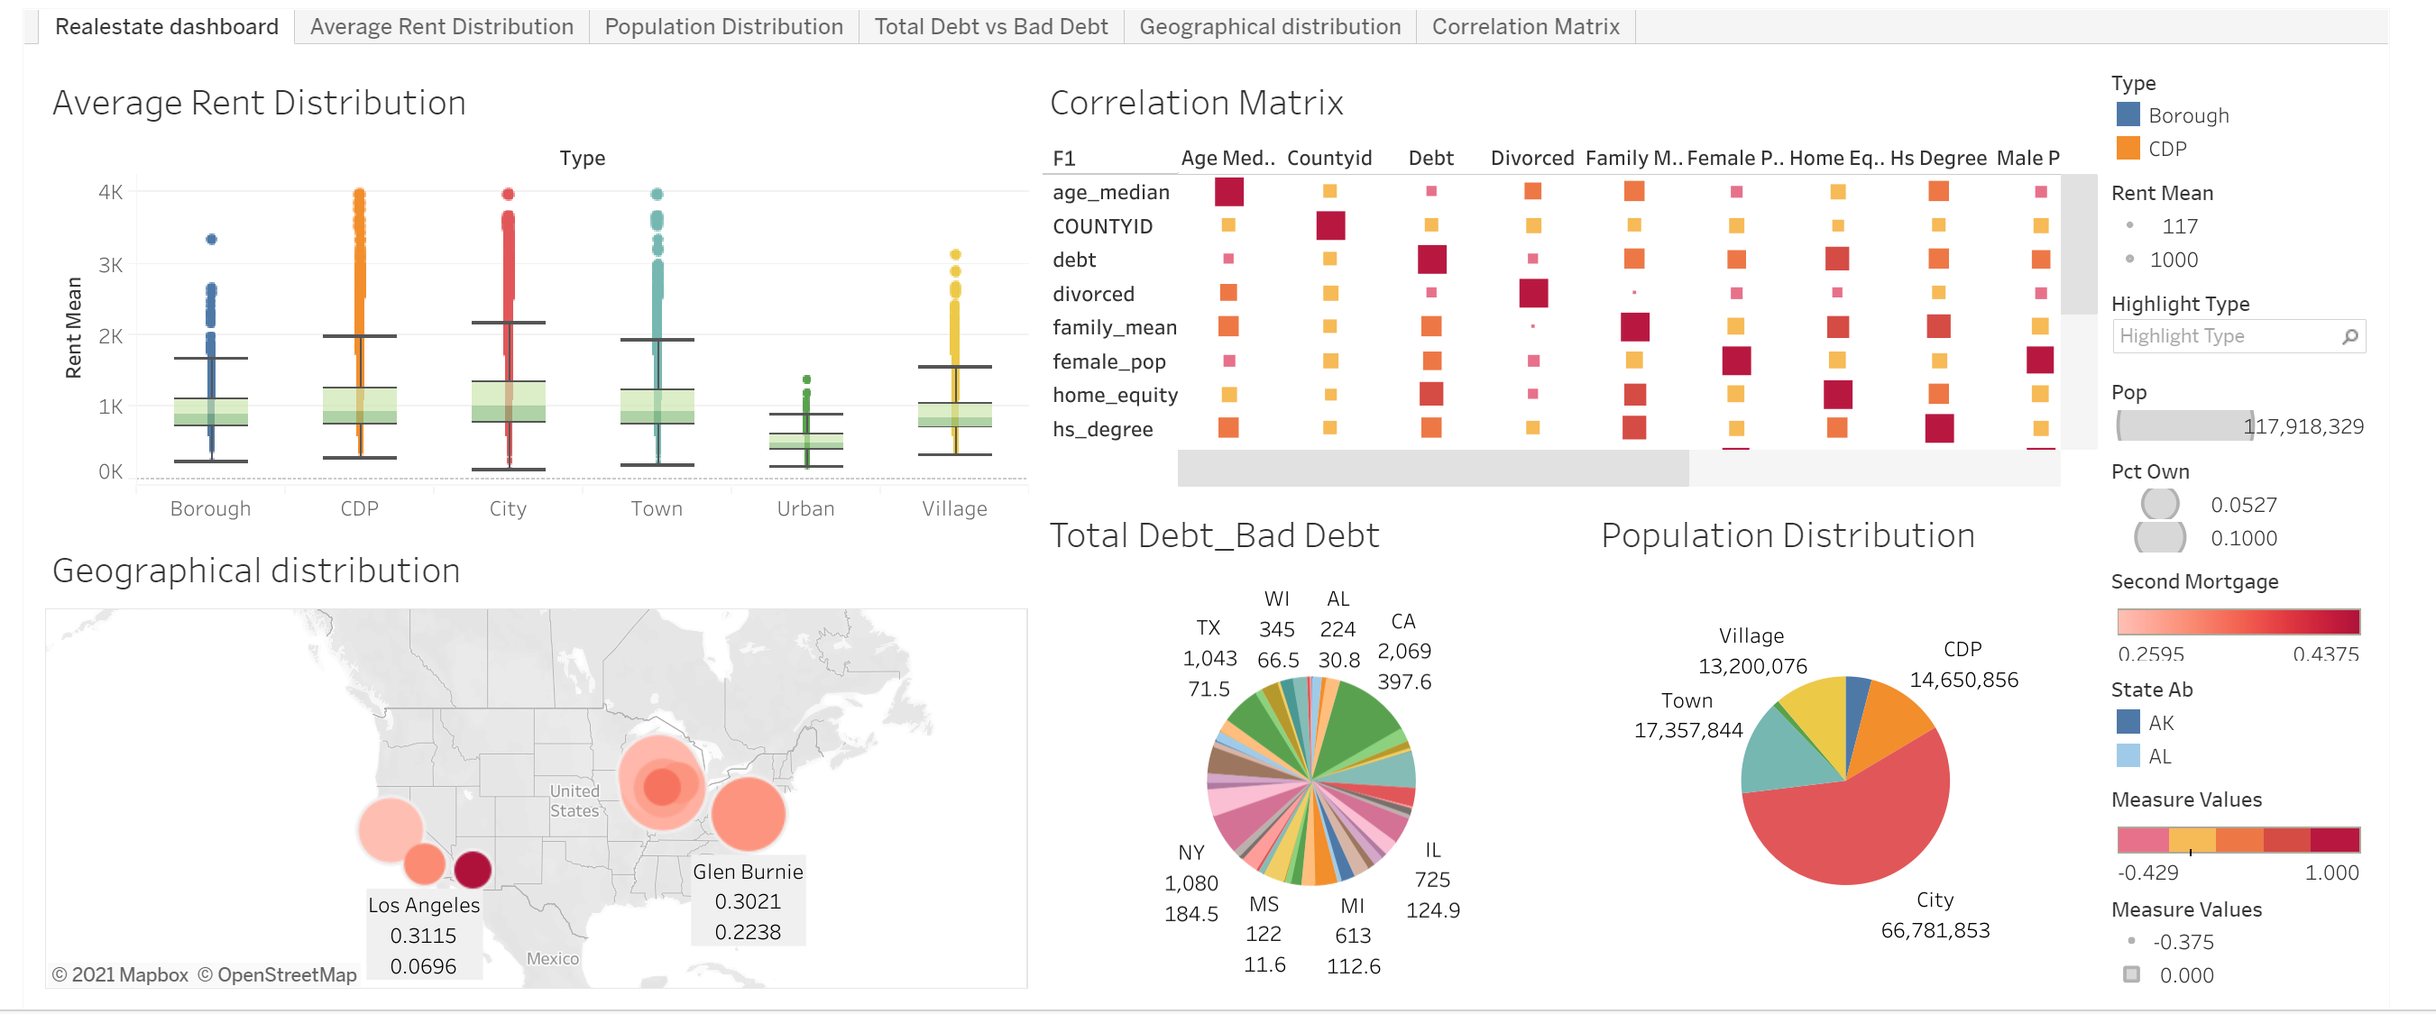
Week 4

Slide 19
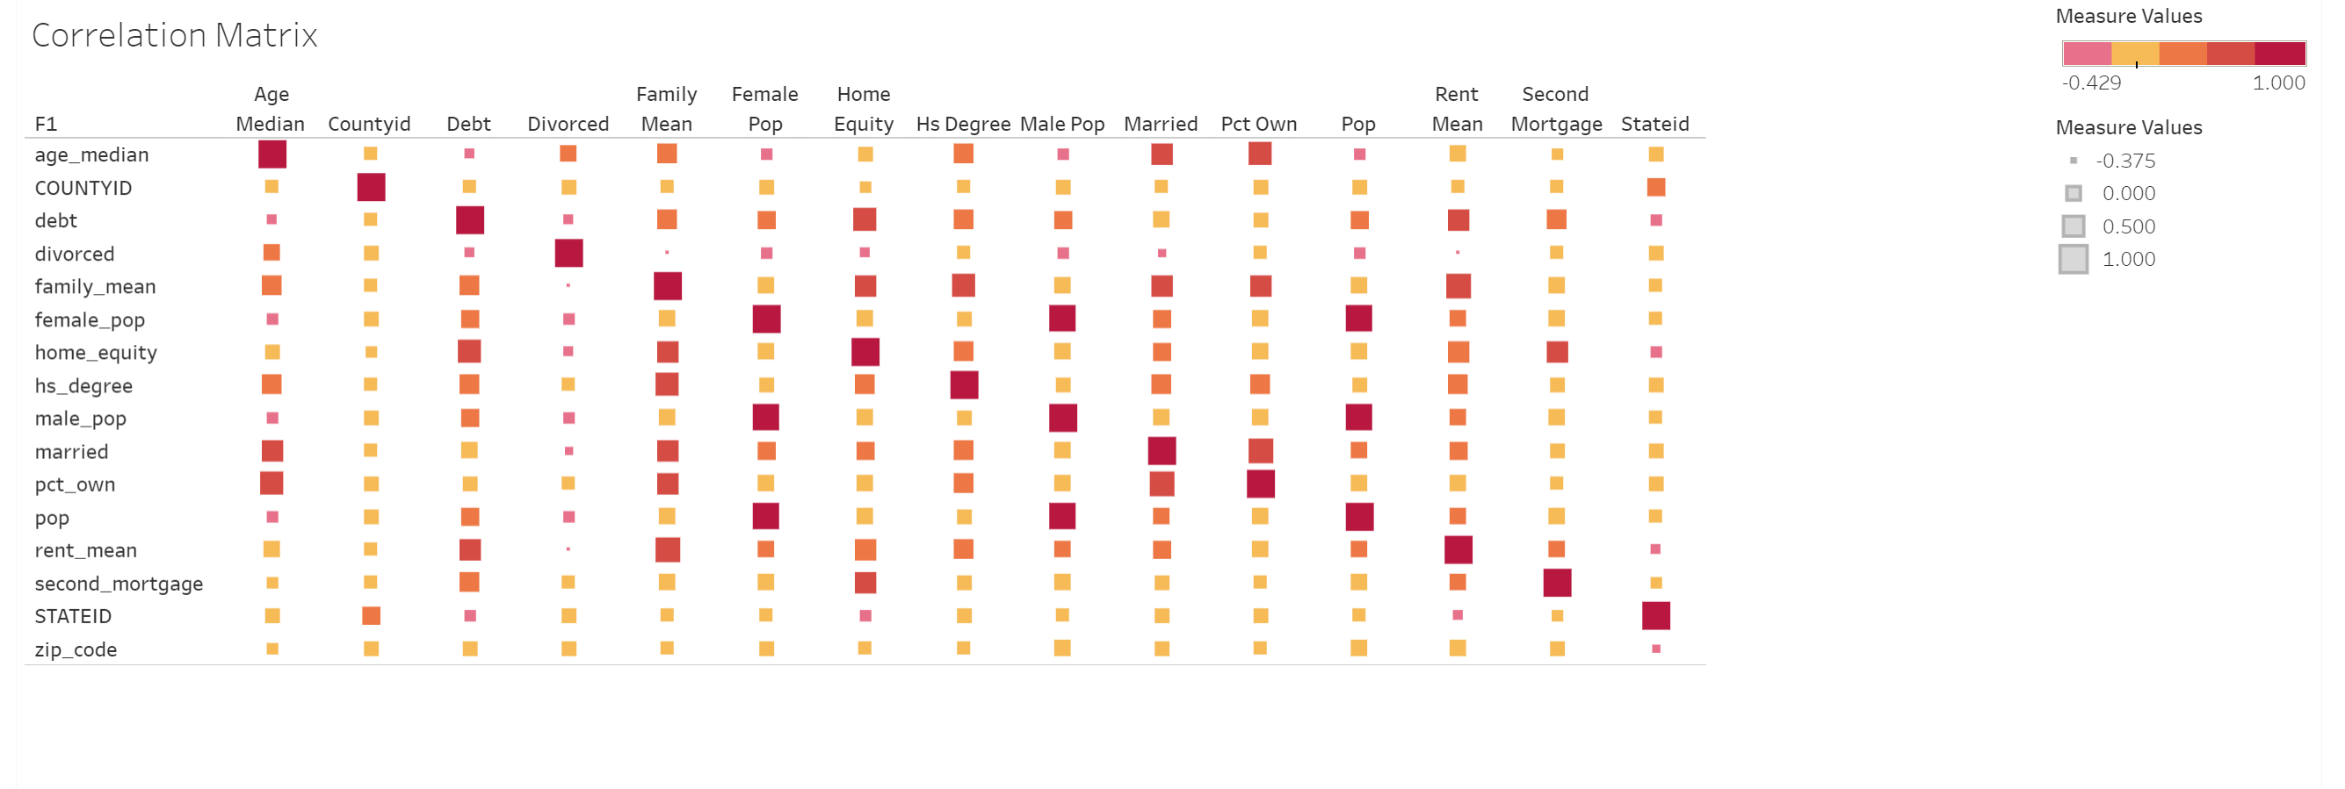
Correlation Matrix

Slide 20
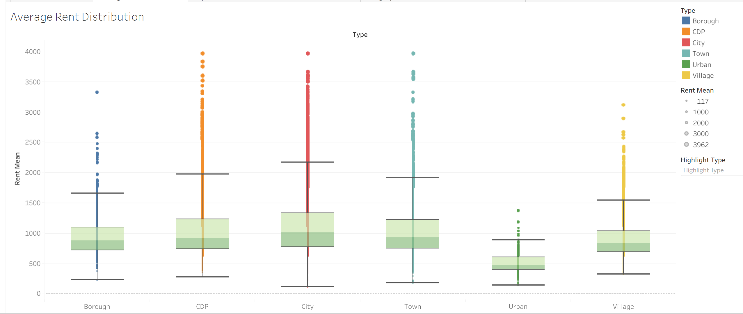
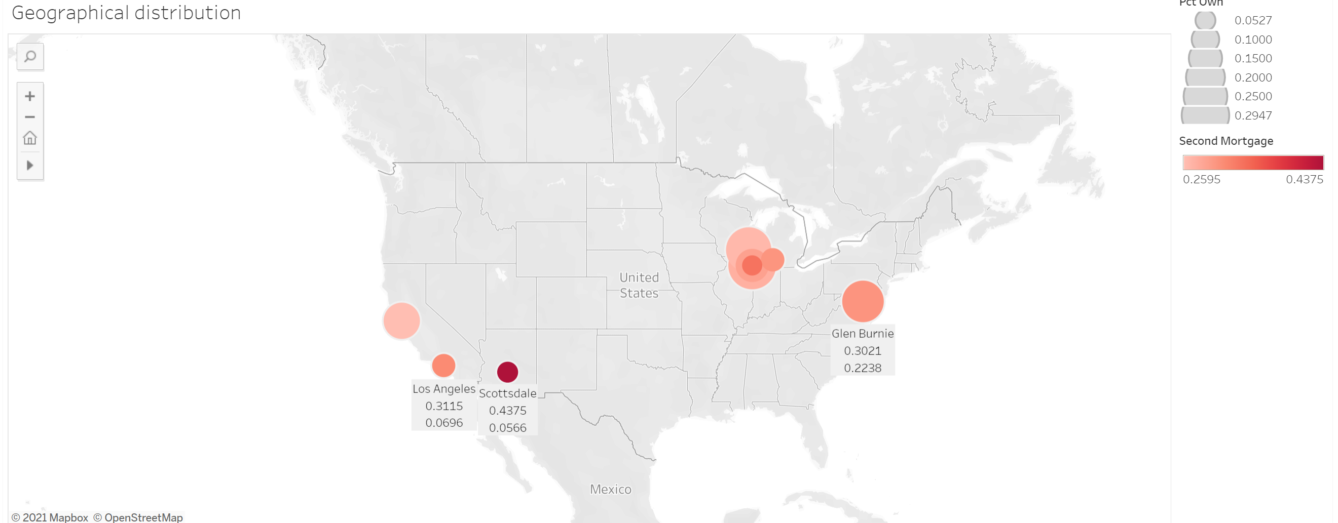
Average Rent & Geographic Distribution

Slide 21
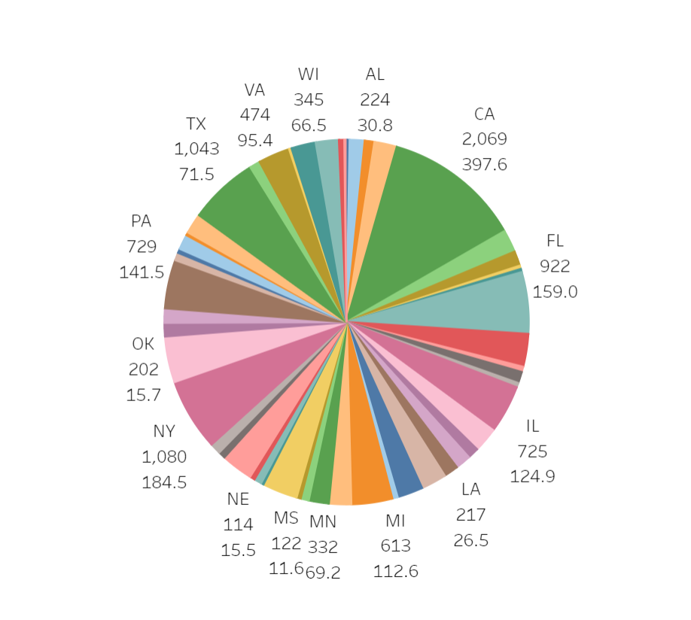
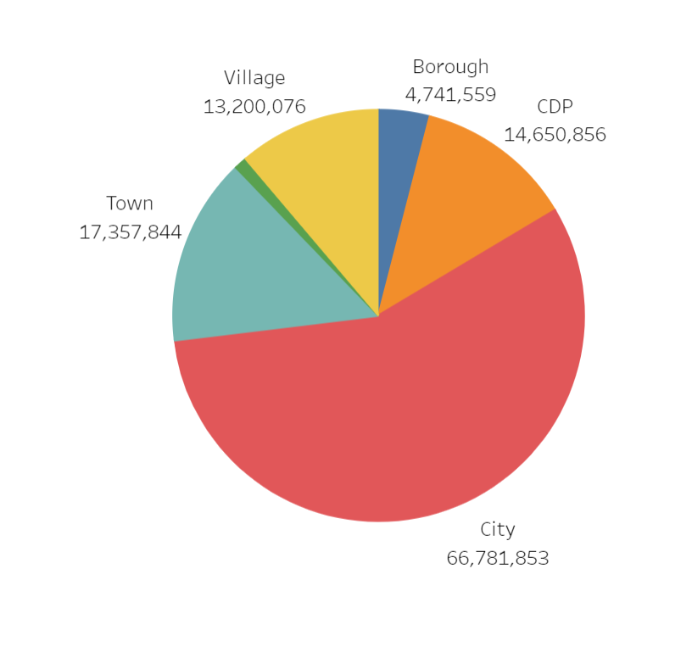
Population Distribution & Debt vs Bad Debt

Slide 22
Key Takeaways
ONE: Understanding Painpoints / Problem
TWO: Domain Challenge
THREE: User Journey / Goals / Objective
FOUR: Analysis Pralysis
FIVE: Repeatable cleansing, analysis and modelling
SIX: Powerful Dashboard & Insight

Slide 23
Thank You
Github Link
…<I’ll Update>……….
Rajesh Nagarjunan

